Slide 1
Setup and Usage
(cont.) To use Handlebars follow the steps:
Create a template
In a script tag with invalid type attribute
<script id="post-template" type="text/x-handlebars-template">
<div class='post'>
<h1 class="post-title">{{title}}</h1>
<p class="post-content">{{{content}}}</p>
</div>
</script>
Render the template
var post = {title: '…', content: '…'},
htmlTemplate = postTemplateNode.innerHTML,
postTemplate = Handlebars.compile(htmlTemplate),
postNode.innerHTML = postTemplate(post);

Slide 2
Creating HTML Templates
HTML templates act much like string.Format() in C# and Java and stringWithFormat: @"…" in Objective-C
Put placeholders within a template string, and replace these placeholders with values
Handlebars.js marks placeholders with double curly brackets {{value}}
When rendered, the placeholders between the curly brackets are replaced with the corresponding value

Slide 3
Creating Templates: Example
Creating the template
<script id="post-template" type="text/x-handlebars-template">
<div class='post'>
<h1 class="post-title">{{title}}</h1>
<p class="post-content">{{content}}</p>
</div>
</script>
Create the JavaScript object and render the template to produce pure HTML code
var post = { title: 'Post Title', content: 'Post content' };
var postTemplateNode = document.getElementById('post-template'),
postTemplateHtml = templateNode.innerHTML,
postTemplate = Handlebars.compile(postTemplateHtml);
domNode.innerHTML = postTemplate(post);

Slide 4
HTML Escaping
Handlebars.js escapes all values before rendering them
If the value should not be escaped there are two possibilities:
Use triple curly brackets in the template string
Mark in the value not to be escaped
Mostly used with helpers
{{{value}}}
var post = { title: '…',
content: new Handlebars.SafeString('…')
};

Slide 5
Handlebars.js Expressions
Handlebars.js supports expressions within the templates
Block expressions
For iterating over a collection of elements
Conditional expressions

Slide 6
Block expressions
Block expressions are used to iterate over a collection of objects (like array)
Created using {{#collection}} and {{/collection}}
Everything between will be evaluated for each object in the collection
<ul class="categories-list">
{{#categories}}
<li class="category-item">
<a href="#/categories/{{id}}">{{name}}</a>
</li>
{{/categories}}
</ul>
The id & name of every object

Slide 7
Conditional Expressions
Render code only if a condition is fulfulled
Using {{#if condition}} {{/if}} or {{unless condition}} {{/unless}}
<h1>Posts</h1>
<ul class="posts">
{{#posts}}
<li>
<strong>
<a href="#/posts/{{id}}">{{title}}</a>
</strong>
{{#if author}}
<span class="author">by {{author}}</span>
{{/if}}
</li>
{{/posts}}
</ul>
If author is false-like value, this code will not be rendered

Slide 8
Handlebars.js Helpers
Handlebars.js helpers are like functions that do predefined job
Build-in helpers:
{{#each collection}} {{/each}}
Much like block expressions but with more control like {{@index}} and {{this}}
{{#with obj}} {{/with}}
Used to minify the path
Write {{prop}} Instead of {{obj.prop}}

Slide 9
Registering Custom Helpers
Handlebars.js supports extension of the built-in helpers
Using Handlebars.registerHelper(…):
Handlebars.registerHelper ('tags', function(tags){
var html = '<ul class="tags-list">',
tag;
for(tag in tags){
html += '<li class="tag">' + tag + '</li>';
}
return new Handlebars.SafeString(html);
});
SageString is mandatory here
Otherwise the result will be escaped

Slide 10
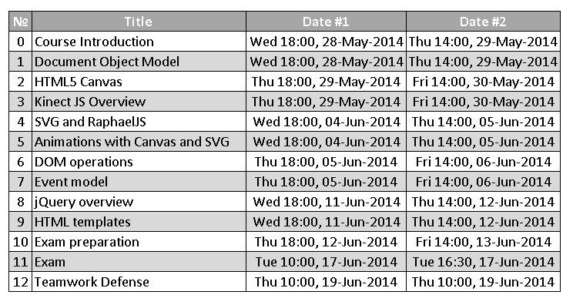
Homework
Create the following using Handlebars.js

Slide 11
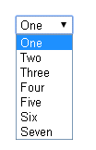
Homework (2)
Create a dynamic select using Handlebars.js
The options in the select should be generated based on a collection of JavaScript objects
Example:
var items = [{
value: 1,
text: 'One'
}, {
value: 2,
text: 'Two'
}];
var selectHTML = selectTemplate(items);

Slide 12

Homework (3)
*Create a jQuery plugin for ListView
Apply a template for each item of a collection
Using the data-template attribute set the ID of the template to use for the items
Must work with different collections and templates
*More examples on the next slides
<ul id="books-list" data-template="book-item-template"></ul>
<script id="book-item-template" type="…">
<li class="book-item">
<a href="/#books/{{id}}">
<strong>{{title}}</strong>
</a>
</li>
</script>
$('#books-list').listview(books);

Slide 13
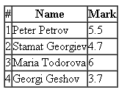
Homework (4)
*(cont.)Create a jQuery plugin for ListView
<table>
<thead>
<tr><th>#</th><th>Name</th><th>Mark</th></tr>
</thead>
<tbody id="students-table" data-template="students-row-template">
</tbody>
</table>
<script id="students-row-template" type="…">
<tr class="student-row">
<td>{{number}}</td>
<td>{{name}}</td>
<td>{{mark}}</td>
</tr>
</script>
$('#students-table').listview(students);

Slide 14
Homework (5)
*Extend the previous task to set the template inside the DOM element, instead of setting it with data-template
<table>
<thead>
<tr><th>#</th><th>Name</th><th>Mark</th></tr>
</thead>
<tbody id="students-table">
<tr class="student-row">
<td>{{number}}</td>
<td>{{name}}</td>
<td>{{mark}}</td>
</tr>
</tbody>
</table>
$('#students-table').listview(students);

